Slide 1
Naive Bayes

Slide 2
Probability Basics
Probability is the branch of mathematics concerning numerical descriptions of how likely an event is to occur, or how likely it is that a proposition is true. The probability of an event is a number between 0 and 1, where, roughly speaking, 0 indicates impossibility of the event and 1 indicates certainty.

Slide 3
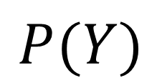
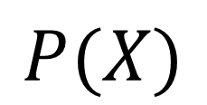
Single event probability:
$$P(X)$$
$$P(Y)$$

Slide 4
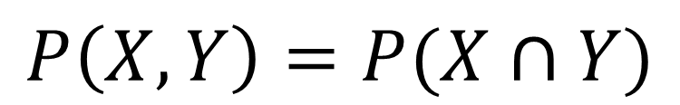
Joint event probability:
$$P\left(X,Y\right)=P(X∩Y)$$

Slide 5
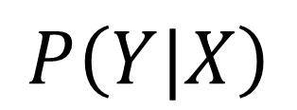
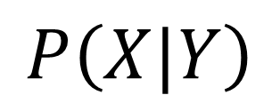
Conditional probability:
$$P\left(X|Y\right)$$
$$P\left(Y|X\right)$$

Slide 6
Joint and conditional relationship:
$$P\left(X,Y\right)=P\left(X|Y\right) ∗P\left(X\right)=P\left(Y|X\right) ∗P\left(Y\right)$$

Slide 7
Example

Slide 8
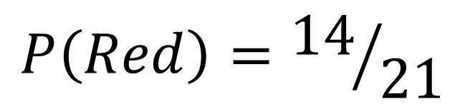
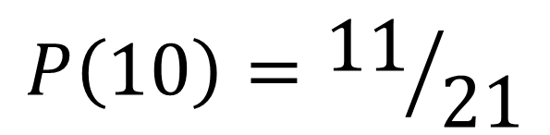
Single event probability:
9
10
6
10
10
10
12
22
10
10
10
10
8
5
10
5
9
10
10
15
14
$$P\left(10\right)={11}/{21}$$
$$P\left(Red\right)={14}/{21}$$

Slide 9
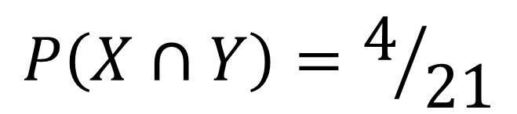
Joint event probability:
9
10
6
10
10
10
12
22
10
10
10
10
8
5
10
5
9
10
10
15
14
$$P\left(X∩Y\right)=4/{21}$$

Slide 10
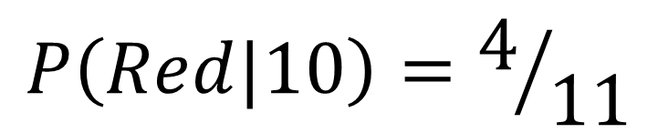
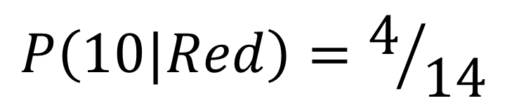
Conditional probability:
9
10
6
10
10
10
10
12
22
10
10
10
10
10
10
8
5
5
9
10
10
10
10
15
14
$$P\left(10|Red\right)=4/{14}$$
$$P\left(Red|10\right)=4/{11}$$

Slide 11
Joint and conditional relationship:
9
10
6
10
10
10
12
22
10
10
10
10
8
5
10
5
9
10
10
15
14
$$P\left(10,Red\right)=P\left(10|Red\right) ∗P\left(10\right)=P\left(Red|10\right) ∗P\left(Red\right)$$
$$P\left(10,Red\right)=P\left(10|Red\right) ∗P\left(10\right)=4/{14} ∗{14}/{21}=4/{21}$$
$$P\left(10,Red\right)=P\left(Red|10\right) ∗P\left(Red\right)=4/{11}∗{11}/{21}=4/{21}$$

Slide 12
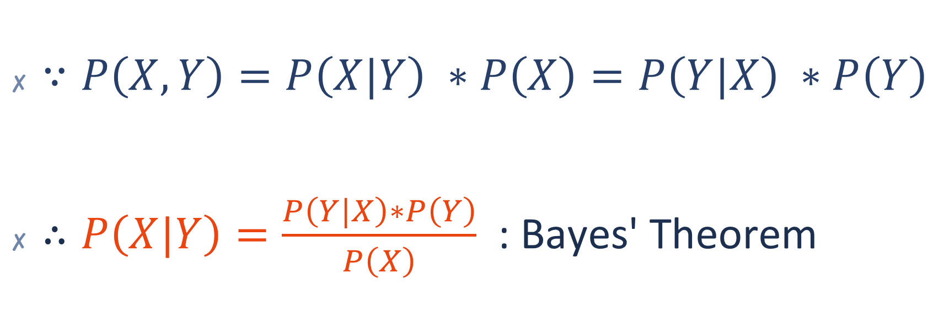
Conclusion
$∵P\left(X,Y\right)=P\left(X|Y\right) ∗P\left(X\right)=P\left(Y|X\right) ∗P\left(Y\right)$
$∴P\left(X|Y\right)=\frac{P\left(Y|X\right)∗P\left(Y\right)}{P\left(X\right)}$ : Bayes' Theorem

Slide 13
Naive Bayes
naive Bayes classifiers are a family of simple "probabilistic classifiers" based on applying Bayes' theorem with strong (naive) independence assumptions between the features

Slide 14
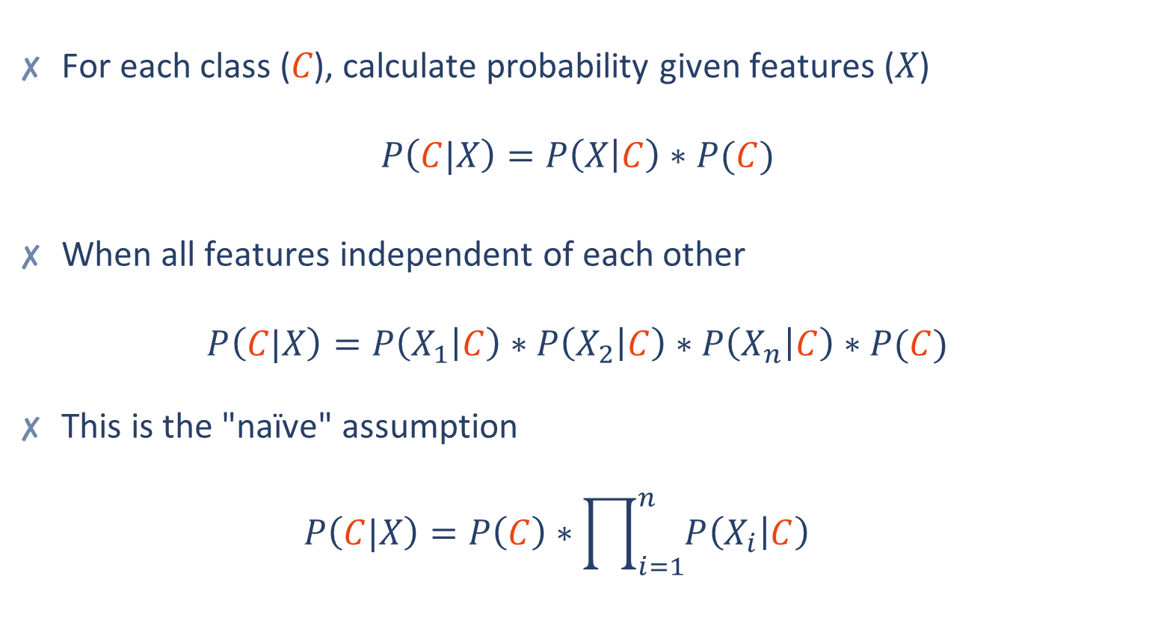
Training Naive Bayes
For each class (𝐶), calculate probability given features (𝑋) $P\left(C|X\right)=P\left(X | C\right)∗P(C)$
When all features independent of each other $P\left(C|X\right)=P\left(X_{1} | C\right)∗P\left(X_{2} | C\right)∗P\left(X_{n} | C\right)∗P(C)$
This is the "naïve" assumption $P\left(C|X\right)=P\left(C\right)∗\prod_{i=1}^{n}{P\left(X_{i} | C\right)}$

Slide 15
Example: Predicting Buy Computer With Naïve Bayes
RID | Age | Income | Student | Credit Rating | Buy computer
1 | Youth | High | No | Fair | No
2 | Youth | High | No | Excellent | No
3 | Middle age | High | No | Fair | Yes
4 | Senior | Medium | No | Fair | Yes
5 | Senior | Low | Yes | Fair | Yes
6 | Senior | Low | Yes | Excellent | No
7 | Middle age | Low | Yes | Excellent | Yes
8 | Youth | Medium | No | Fair | No
9 | Youth | Low | Yes | Fair | Yes
10 | Senior | Medium | Yes | Fair | Yes
11 | Youth | Medium | Yes | Excellent | Yes
12 | Middle age | Medium | No | Excellent | Yes
13 | Senior | Medium | No | Excellent | No

Slide 16
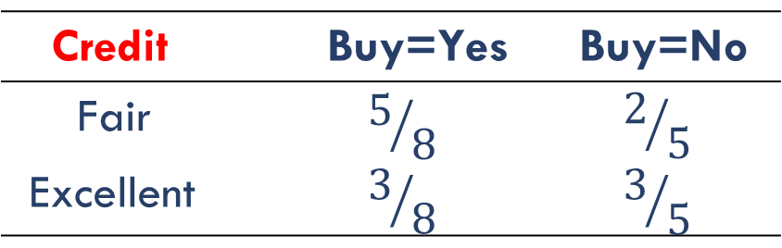
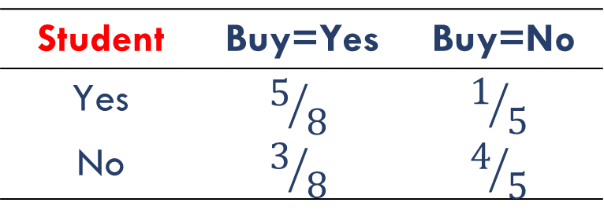
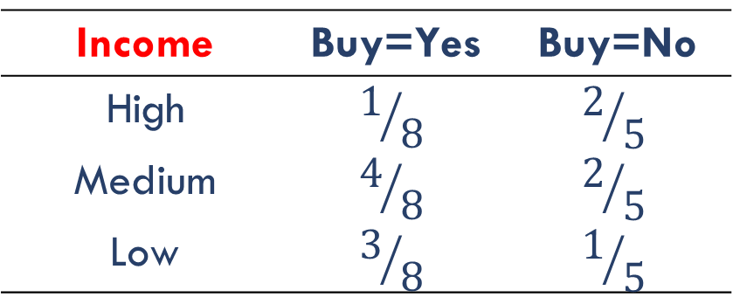
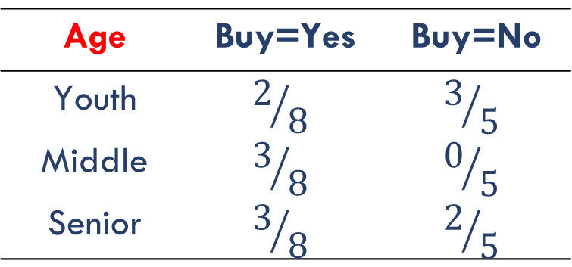
Example: Training Naive Bayes Buy Computer Model
$P(Buy=Yes) = 8/{13}$ $P(Buy=No) = 5/{13}$
Age | Buy=Yes | Buy=No
Youth | $$2/8$$ | $$3/5$$
Middle | $$3/8$$ | $$0/5$$
Senior | $$3/8$$ | $$2/5$$
Income | Buy=Yes | Buy=No
High | $$1/8$$ | $$2/5$$
Medium | $$4/8$$ | $$2/5$$
Low | $$3/8$$ | $$1/5$$
Student | Buy=Yes | Buy=No
Yes | $$5/8$$ | $$1/5$$
No | $$3/8$$ | $$4/5$$
Credit | Buy=Yes | Buy=No
Fair | $$5/8$$ | $$2/5$$
Excellent | $$3/8$$ | $$3/5$$

Slide 17
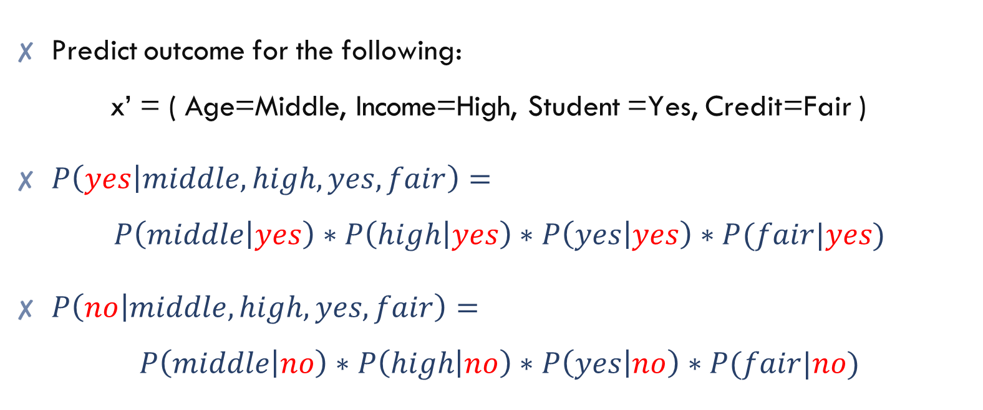
Example: Predicting Buy Computer With Naïve Bayes
Predict outcome for the following: x’ = ( Age=Middle, Income=High, Student =Yes, Credit=Fair )
$P\left(yes | middle,high,yes,fair\right)=$ $P\left(middle | yes\right)∗P\left(high | yes\right)∗P\left(yes | yes\right)∗P(fair|yes)$
$P\left(no | middle,high,yes,fair\right)=$ $P\left(middle | no\right)∗P\left(high | no\right)∗P\left(yes | no\right)∗P(fair|no)$

Slide 18
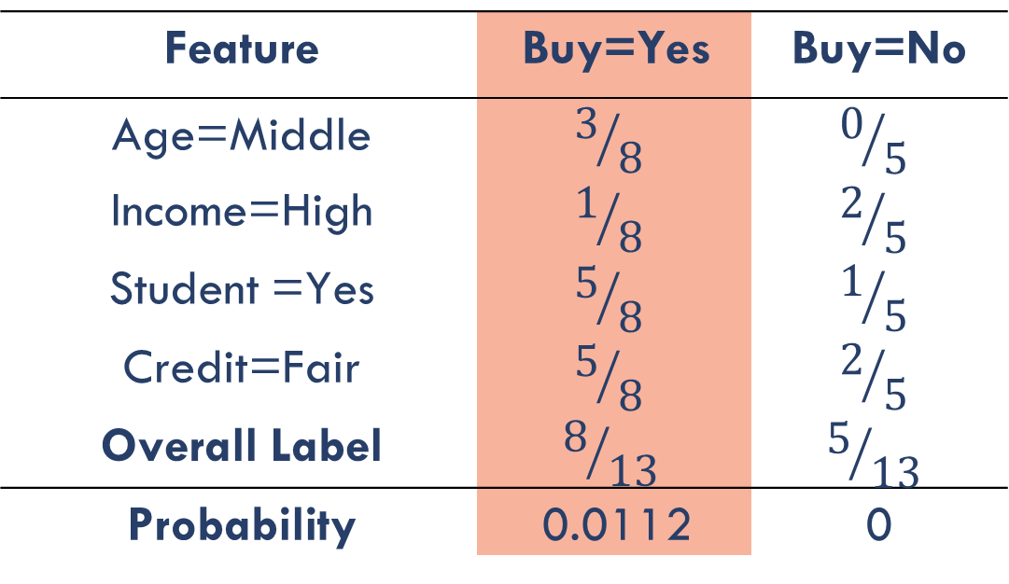
Example: Predicting Buy Computer With Naïve Bayes
Predict outcome for the following: x’ = ( Age=Middle, Income=High, Student =Yes, Credit=Fair )
Feature | Buy=Yes | Buy=No
Age=Middle | $$3/8$$ | $$0/5$$
Income=High | $$1/8$$ | $$2/5$$
Student =Yes | $$5/8$$ | $$1/5$$
Credit=Fair | $$5/8$$ | $$2/5$$
Overall Label | $$8/{13}$$ | $$5/{13}$$
Probability | 0.0112 | 0

Slide 19
Types of Naïve Bayes
Naïve Bayes Model | Data Type
Bernoulli | Binary (T/F)
Multinomial | Discrete (e.g. count)
Gaussian | Continuous

Slide 20
Combining Feature Types
Problem : Model features contain different data types (continuous and categorical)
Solutions : Bin continuous features to create categorical ones and fit multinomial model

Slide 21
The Naive Bayes algorithm
Strengths | Weaknesses
Simple, fast, and very effective Does well with noisy and missing data Requires relatively few examples for training, but also works well with very large numbers of examples Easy to obtain the estimated probability for a prediction | Relies on an often faulty assumption of equally important and independent features Not ideal for datasets with many numeric features Estimated probabilities are less reliable than the predicted classes
popular examples : of Naïve Bayes Algorithm are spam filtration, Sentimental analysis, and classifying articles.

Slide 22
Naïve Bayes: The Syntax
Import the class containing the classification method
from sklearn.naive_bayes import BernoulliNB
Create an instance of the class
BNB = BernoulliNB(alpha=1.0)
Fit the instance on the data and then predict the expected value
BNB = BNB.fit(X_train, y_train)
y_predict = BNB.predict(X_test)
Other naïve Bayes models: MultinomialNB, GaussianNB.

Slide 23
Practical Example

Slide 24
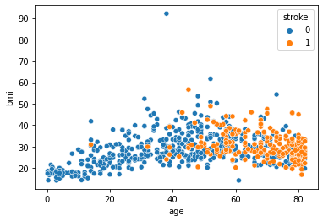

Slide 25
